Slide 1
Snake Game – Web Development Project
- Debasish Panda
This is a browser-based implementation of the classic Snake Game built using HTML, CSS, and JavaScript.
Designed as a part of my web development learning journey.
Focused on creating an interactive and nostalgic gaming experience.
Developed using core frontend technologies.
Simple logic implementation and clean UI.
No frameworks or libraries – Vanilla JavaScript.

Slide 2
Working of the Game
The game board is rendered in the browser using the <canvas> element.
The snake moves automatically and can be directed using arrow keys.
The score increases as the snake eats food.
Collision with walls or itself ends the game.
Snake position and movement controlled using arrays and coordinates.
Food spawns randomly.
Game loop maintained using setInterval().
Tech Stack
HTML – structure of the game board.
CSS – styling the game board and UI.
JavaScript – game logic, controls, and rendering.

Slide 3
Uses and Applications
Demonstrates foundational JavaScript skills.
Can be used as a beginner project to understand game logic.
Great for learning DOM manipulation and keyboard event handling.
Can be extended into a mobile game or advanced version with AI.
Advantages | Disadvantages
Fully functional in browser, no installation needed. | No mobile or touch support.
Clean and lightweight code. | No sound effects or animations.
Easy to understand and extend. | Basic design – not very visually rich.
Great for learning game logic and HTML Canvas. | No difficulty levels or leaderboard.

Slide 4
Future Scope
Add touch/mobile controls.
Include sound effects and background music.
Implement score saving using localStorage or backend.
Add levels, power-ups, or multiplayer mode.
Improve UI with animations and themes.
Project Link & Contact Info
GitHub Repo: https://github.com/Debasish-1969/Snake-game
Name – Debasish Panda
Email – debasish2003panda@gmail.com

Slide 5
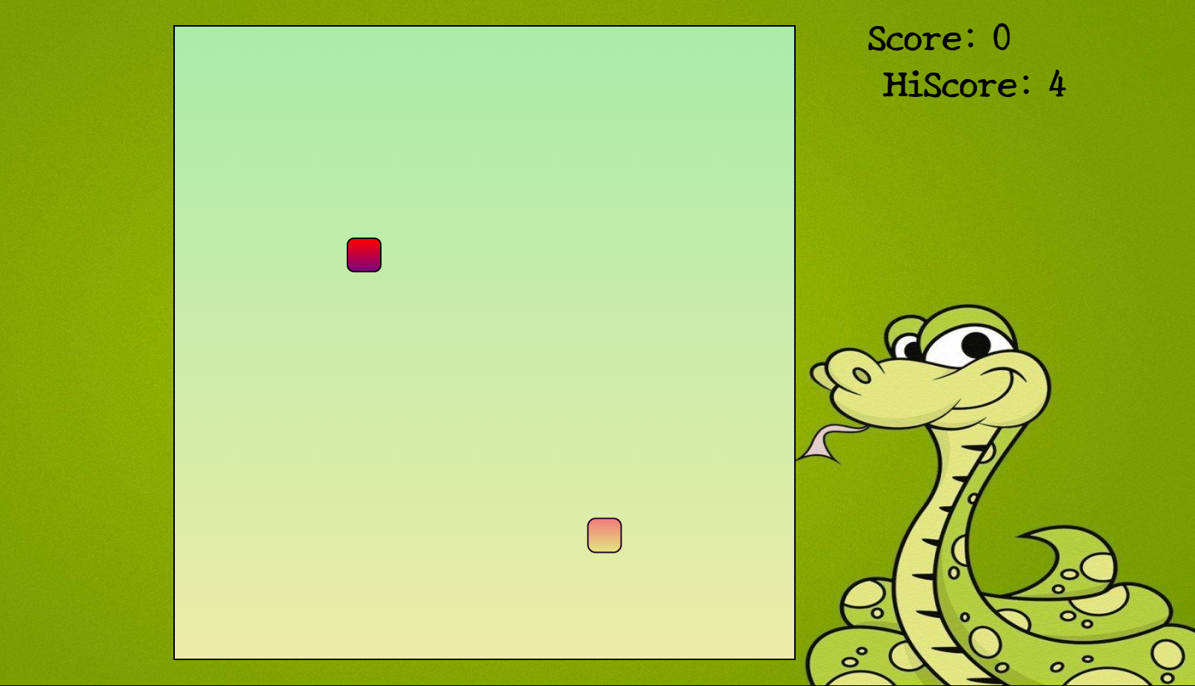
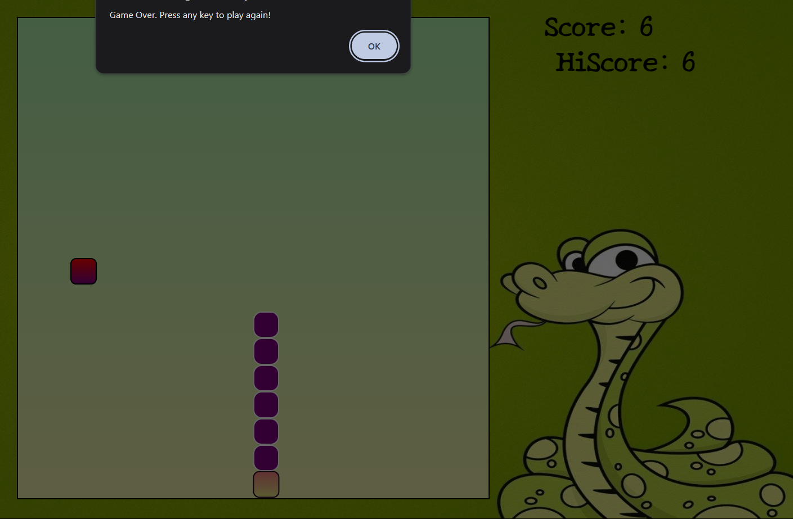
Output / Screenshots

